Slide 1
Guided Capstone Slide deck for Executive Team
By Ashley nalikka

Slide 2
Problem Identification
The problem that needs to be solved is developing a pricing model for ski resort tickets in the market segment
The purpose is to aim to build a predictive model for ticket price based on the number of facilities, or properties boasted by resorts.
The model will be used to provide guidance for Big Mountain’s pricing and future facility investment plans.

Slide 3
Recommendations and Key Findings
The target price for AdultWeekday is $25 - $100 while the target price for Adultweekend is $20 - $60.
The random forest model has a lower cross-validation mean absolute error by almost $1. It also exhibits less variability.
The best model is the rf_grid_cv.best_estimator_ because it marginally improved upon the default CV results.
Big Mountain currently charges $81. Big Mountain Resort modelled price is $85.70, actual price is $81.00. Even with the expected mean absolute error of $9.84, this suggests there is room for an increase.
This scenario of adding a new chairlift increases support for ticket price by $1.29.
Permanently closing down up to 10 of the least used runs doesn't impact any other resort statistics.
The cost of the trams would also be useful as they are main form of transportation at a ski resort.

Slide 4
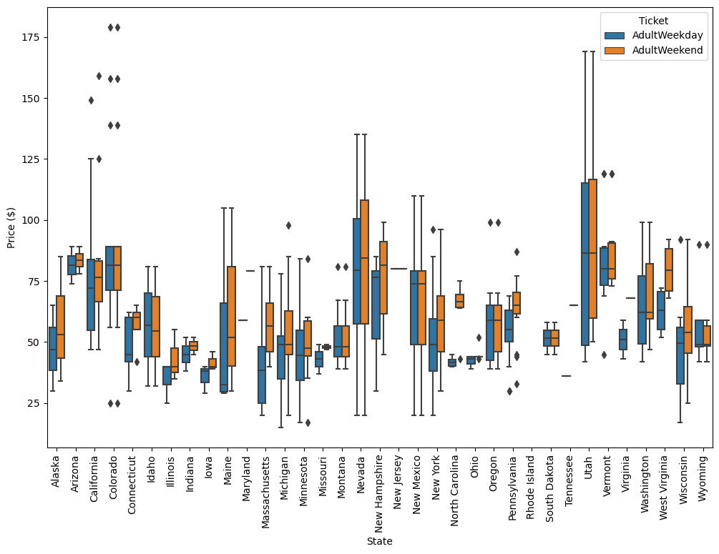
Modeling results and analysis
Most prices appear to lie in a broad band from around 25 to over 100 dollars.
Some States show more variability than others.
Montana and South Dakota, for example, both show fairly small variability as well as matching weekend and weekday ticket prices.
Nevada and Utah, on the other hand, show the most range in prices.
Some States, notably North Carolina and Virginia, have weekend prices far higher than weekday prices.

Slide 5
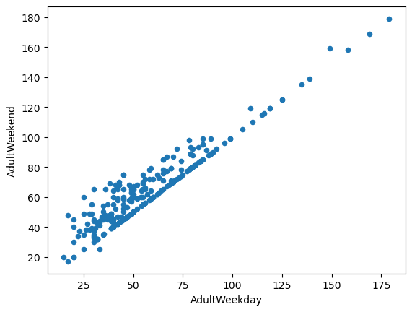
Modeling results and analysis cont’d
There is a clear line where weekend and weekday prices are equal.
The correlation between AdultWeekday and AdultWeekend is almost a perfect line meaning they are positively correlated.
Weekend prices being higher than weekday prices seem restricted to sub $100 resorts.

Slide 6
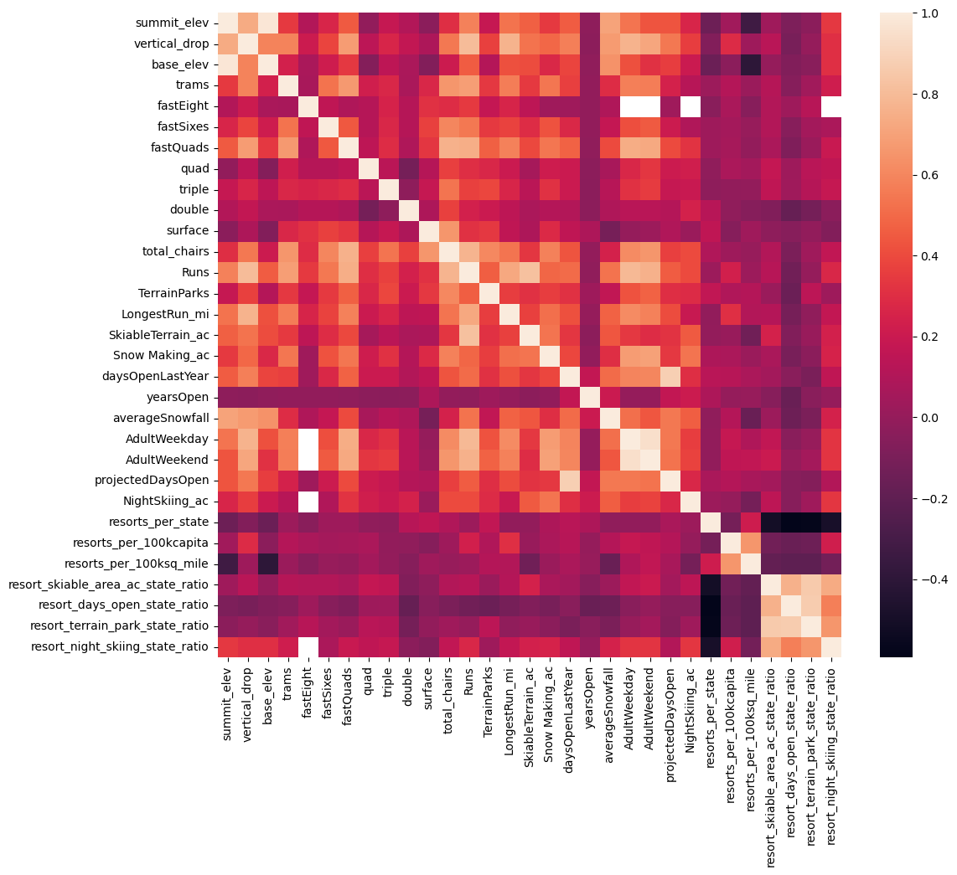
Modeling results and analysis cont’d
If you increase the number of resorts in a state, the share of all the other state features will drop for each.
An interesting observation in this region of the heatmap is that there is some positive correlation between the ratio of night skiing area with the number of resorts per capita.
It seems that when resorts are more densely located with population, more night skiing is provided.

Slide 7
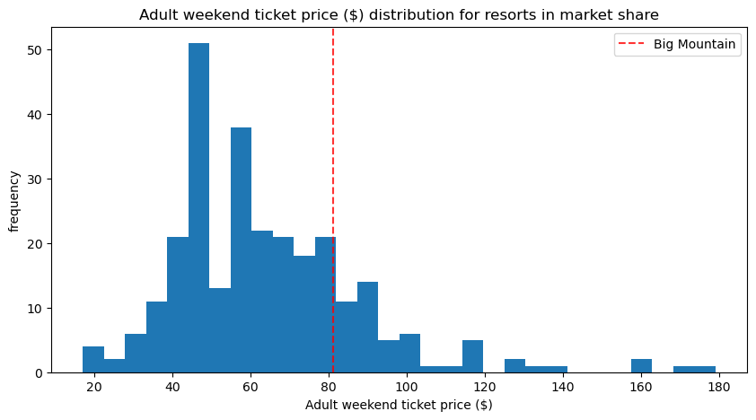
Modeling results and analysis cont’d
Big Mountain currently charges $81.
Big Mountain Resort modelled price is $85.70, actual price is $81.00.
Even with the expected mean absolute error of $9.84, this suggests there is room for an increase.

Slide 8
Summary & Conclusion
The fact that our resort seems to be charging that much less that what's predicted suggests our resort might be undercharging.
But if ours is mispricing itself, are others? It's reasonable to expect that some resorts will be "overpriced" and some "underpriced."
Or if resorts are pretty good at pricing strategies, it could be that our model is simply lacking some key data?
Certainly we know nothing about operating costs, for example, and they would surely help.

